Slide 1

CHOCO DE LUXE BUSINESS PERFORMANCE DASHBOARD
TOOLS USED: TABLEAU
SABINA NAAWMINBONG
OCTOBER 17, 2025

Slide 2
BUSSINESS INTRODUCTION
Choco de Luxe is a premium Belgian chocolate brand with operations across Europe. The company distributes artisanal chocolate bars, bites, and confections through retail, online, and supermarket channels. With a growing product line, Choco de Luxe focuses on maintaining high-quality standards, expanding market share, and tailoring sales strategies to regional performance and customer preferences.
PROBLEM STATEMENT
Choco de Luxe lacks a unified, data-driven system to track product, sales, and delivery performance across Europe. This has led to inconsistent regional results and limited visibility for management to make informed decisions. The company needs actionable insights to improve sales strategy, delivery efficiency, and overall market performance.

Slide 3
PROJECT OBJECTIVES
The project aims to analyze Choco de Luxe’s sales performance across locations, channels, and product lines, identifying inefficiencies and growth opportunities.
Interactive Tableau dashboards were developed to support data-driven decisions on product positioning and sales strategies.
EXPECTATIONS
As the Data Analyst at Choco de Luxe, the role involves evaluating sales performance across locations and channels, measuring salesperson productivity, and analyzing product-level profitability.
The goal is to uncover insights into organic product demand, optimize sales strategies, and enhance overall business efficiency.

Slide 4
DATA DICTIONARY SUMMARY
1. Sales Fact Table Contains core transactional data, including:
Transaction details (ID, Date, Salesperson, Product, and Location).
Sales Channel and Delivery Status.
Performance metrics such as Boxes Shipped.
2. Location Dimension Table Stores geographical information:
Location ID, Country, City, and Region of sales activities.
3. Salesperson Dimension Table Includes personnel-related details:
Salesperson ID, Name, Email, and Hire Date.
4. Product Dimension Table Defines product-specific attributes:
Product ID, Name, Category, Cocoa %, Cost, Price, and Organic Indicator.

Slide 5
PROJECT OBJECTIVES
Evaluate location performance to identify high and low-performing regions.
Analyze channel effectiveness to understand profitability and sales contribution.
Assess salesperson productivity against profit targets and sales volume.
Measure product-level profitability across product lines and categories.
Compare organic vs. non-organic demand to guide future marketing and product strategies.

Slide 6
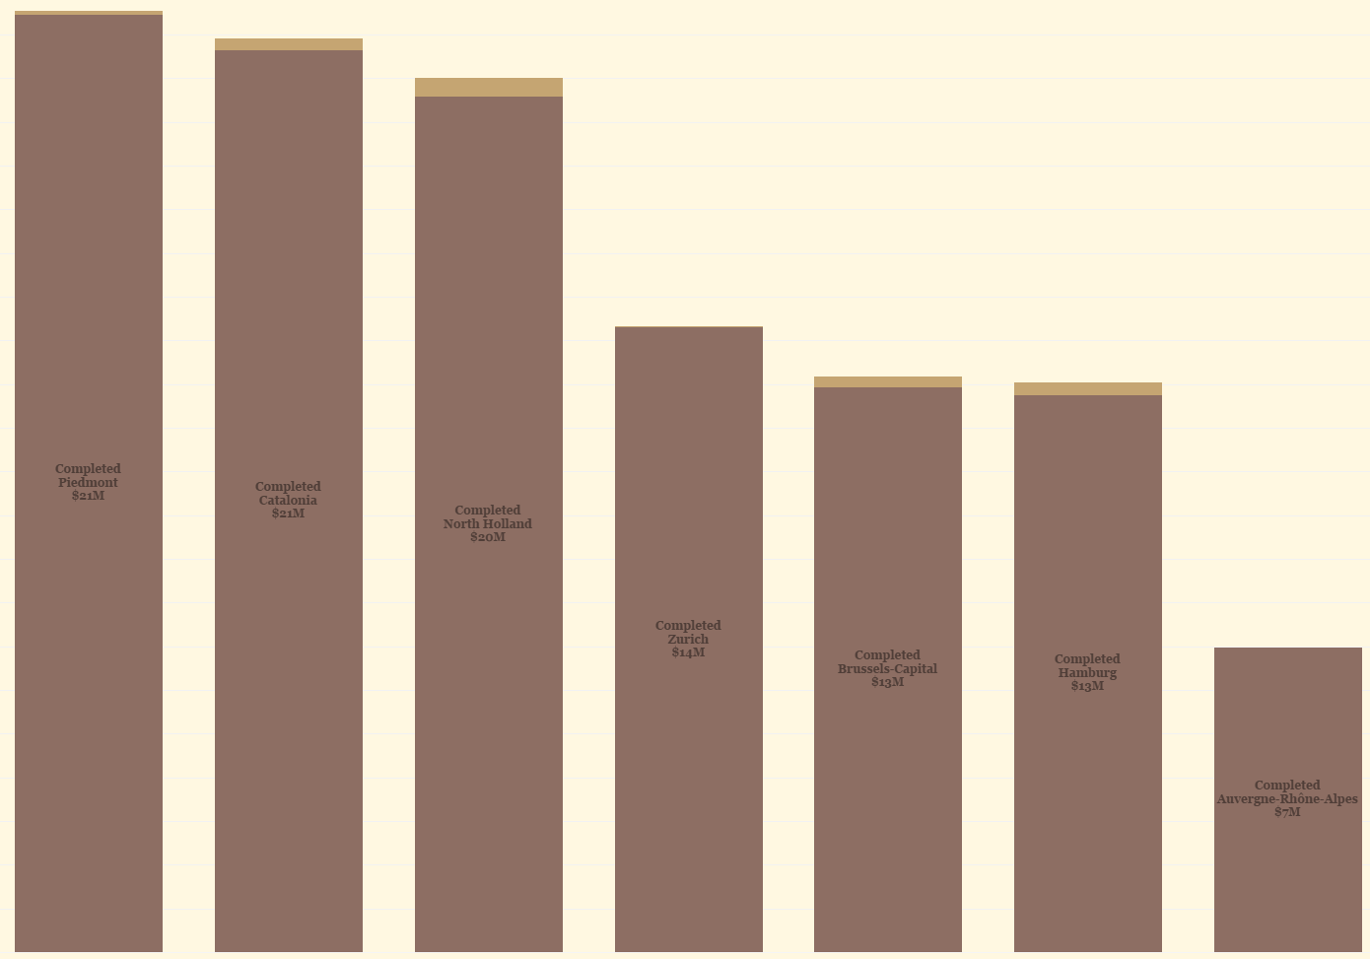
LOCATION SALES PERFORMANCE
INSIGHTS
Piedmont and Catalonia lead in sales performance, each generating $21M, indicating strong market penetration and effective sales execution.
North Holland follows closely with $20M, showing stable growth potential.
Zurich ($14M) and Brussels-Capital ($13M) fall in the mid-range — consistent but below top-tier regions.
Auvergne-Rhône-Alpes significantly underperforms with $7M, suggesting weak demand, lower distribution reach, or ineffective marketing in that region.
All regions show completed deliveries, reflecting solid fulfillment efficiency across the board.
RECOMMENDATIONS
Replicate Top-Region Strategies: Study successful sales and marketing practices from Piedmont and Catalonia to apply in mid- and low-performing regions.
Enhance Market Presence in Low-Performing Areas: Focus on Auvergne-Rhône-Alpes by improving local promotions, partnerships, and delivery coverage.
Targeted Regional Campaigns: Invest in regional-level campaigns for Zurich and Brussels-Capital to boost customer engagement and drive growth.
Data-Driven Resource Allocation: Allocate sales budgets and inventory proportionally based on regional performance and potential market size.
Monitor Regional Profit Margins: Track cost-to-revenue ratios by region to ensure that high sales volumes translate into sustainable profitability.

Slide 7
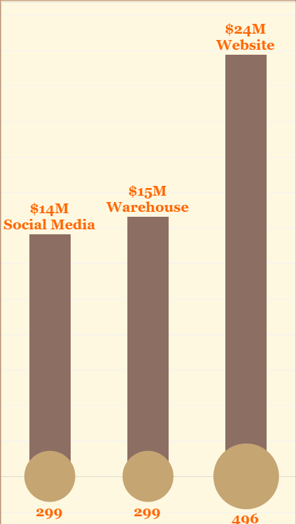
PROFITABILITY BASED ON SALES CHANNELS
INSIGHTS
Website drives the highest profit ($24M) and transactions (496), proving it’s the strongest channel.
Warehouse ($15M) shows solid performance through physical or wholesale sales.
Social Media ($14M) performs moderately, showing potential for digital growth.
Online channels outperform offline ones, reflecting a shift in customer buying behavior.
RECOMMENDATIONS
Boost website efficiency — improve UX, checkout flow, and ad targeting to sustain profit growth.
Strengthen social media marketing through influencer partnerships and paid ad campaigns.
Integrate online & offline sales — introduce click-and-collect or bundle offers.
Adopt an omnichannel approach to maintain consistency in pricing, experience, and brand identity.

Slide 8
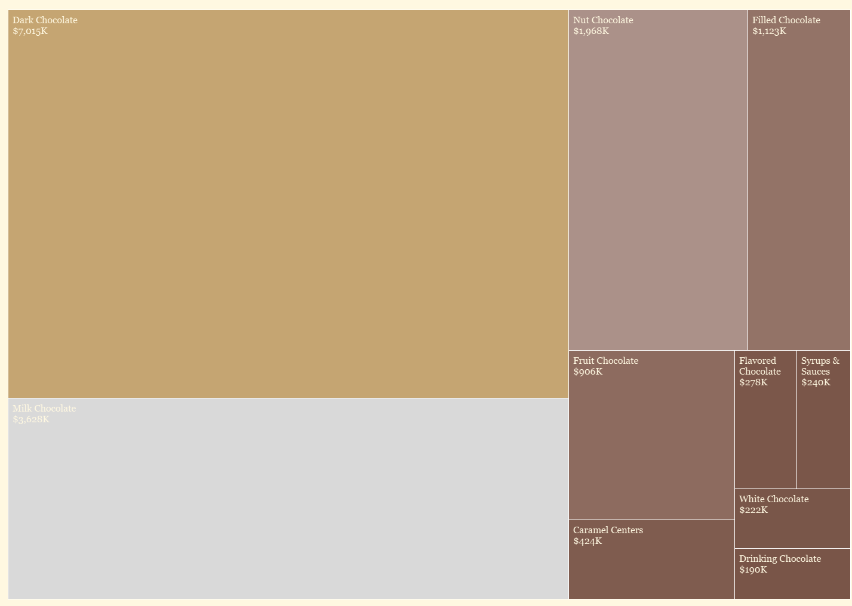
Margin Contributions
INSIGHTS
Dark Chocolate leads with $7.0M, showing strong market demand and premium positioning.
Milk Chocolate ($3.6M) performs well, appealing to a broader consumer base.
Nut ($1.9M) and Filled Chocolate ($1.1M) contribute moderately, indicating niche appeal.
Lower-performing categories like Flavored, White, and Drinking Chocolate (<$300K) show limited traction.
RECOMMENDATIONS
Prioritize Dark & Milk Chocolate — maintain supply, expand SKUs, and invest in marketing.
Enhance visibility for Nut & Filled Chocolates through bundling or seasonal promotions.
Reassess low-performing lines — consider rebranding or limited-edition strategies.
Leverage consumer insights to diversify product mix and meet emerging taste preferences.

Slide 9
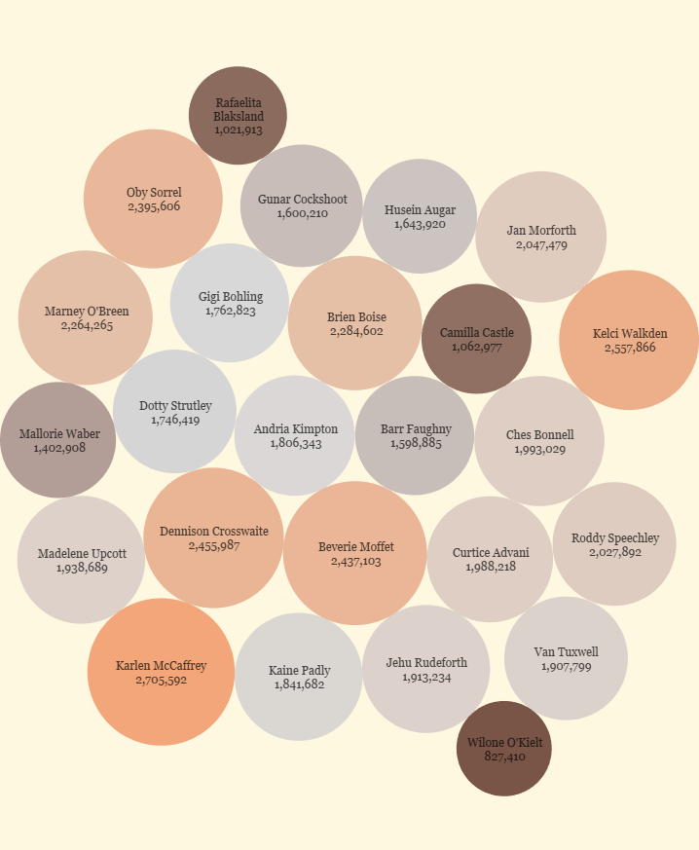
INDIVIDUAL SALES PERFORMANCE
INSIGHTS
Every salesperson performed beyond expectations, exceeding the €100,000 profit target.
Top achievers like Karlen (2.7M), Kelci (2.5M), and Dennison (2.45M) show strong sales skills and great customer relationships.
The results prove that Choco de Luxe’s sales team is highly productive and that demand for its products remains strong across all markets.
Overall, the team demonstrates excellent engagement, consistency, and growth potential.
RECOMMENDATIONS
Celebrate success — reward the team for outstanding performance to boost morale and motivation.
Raise performance goals slightly to challenge the team and maintain momentum.
Encourage knowledge sharing — let top performers mentor others on effective sales strategies.
Continue performance tracking through interactive dashboards (Power BI/Tableau) for ongoing monitoring and improvement.

Slide 10
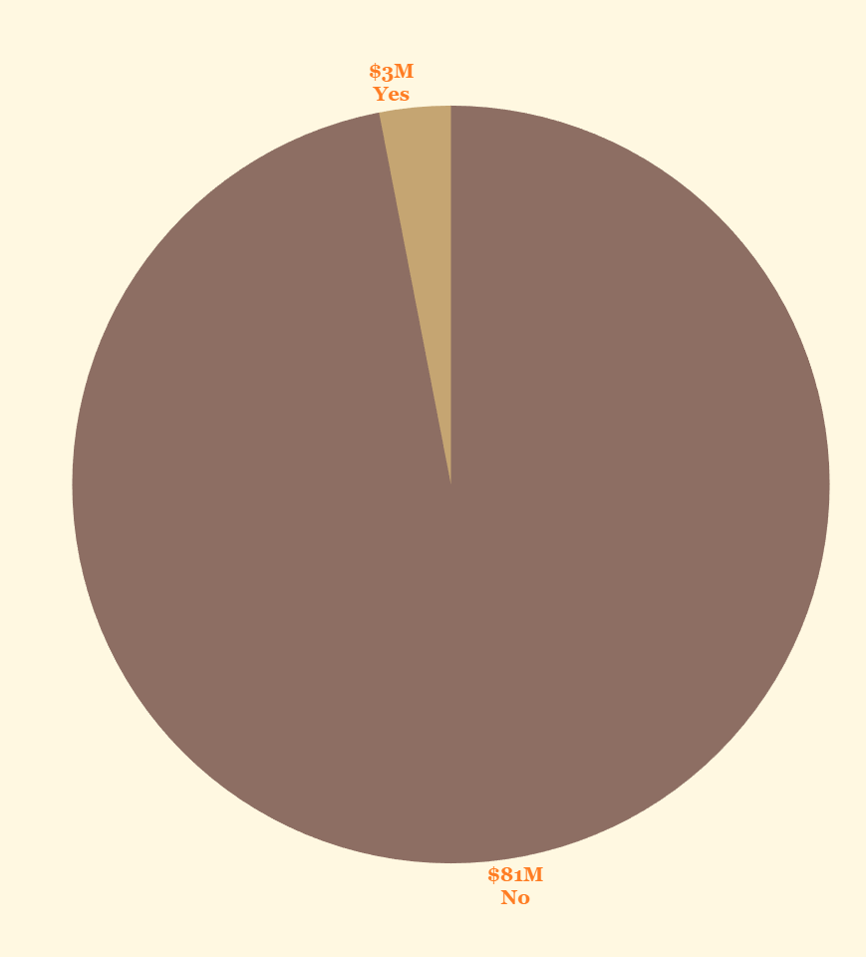
SALES PERFORMANCE/ORGANIC & NON-ORGANIC
KEY INSIGHT: Non-organic products dominate at $81M vs $3M organic sales. RECOMMENDATION: Consider growing organic product marketing to capture the increasing sustainability-conscious market segment.

Slide 11
OVERALL INSIGHTS
Strong regional performance is led by Piedmont, Catalonia, and North Holland (≈$20–21M each), indicating consistent market dominance in Southern and Western Europe.
Online sales channels, particularly the Website ($24M), drive the highest profitability, proving that digital platforms outperform traditional ones like warehouses and social media.
Dark Chocolate ($7M) and Milk Chocolate ($3.6M) remain the best-selling products, reflecting strong consumer preference for core, premium varieties.
Top-performing sales reps such as Karlen McCaffrey and Kelci Walkden far exceed the profit target of €100,000, while a few underperformers suggest potential for focused coaching or territory reassignment.
Overall, Choco de Luxe shows solid growth potential with well-performing regions, products, and sales channels—but improvement opportunities remain in underperforming cities and product lines.

Slide 12
OVERALL RECOMMENDATIONS
Enhance digital sales investments — strengthen e-commerce platforms and optimize website campaigns since they yield the highest profitability.
Expand distribution in high-performing regions while addressing low-performing areas (e.g., Auvergne-Rhône-Alpes) with local marketing initiatives.
Focus marketing efforts on Dark and Milk Chocolates, and consider repositioning or phasing out low-demand products like White or Drinking Chocolate.
Implement data-driven sales management — use dashboards to track salesperson KPIs, delivery efficiency, and regional trends in real time.
Encourage cross-department collaboration between sales, marketing, and supply chain teams to ensure consistent product availability and customer satisfaction.

Slide 13
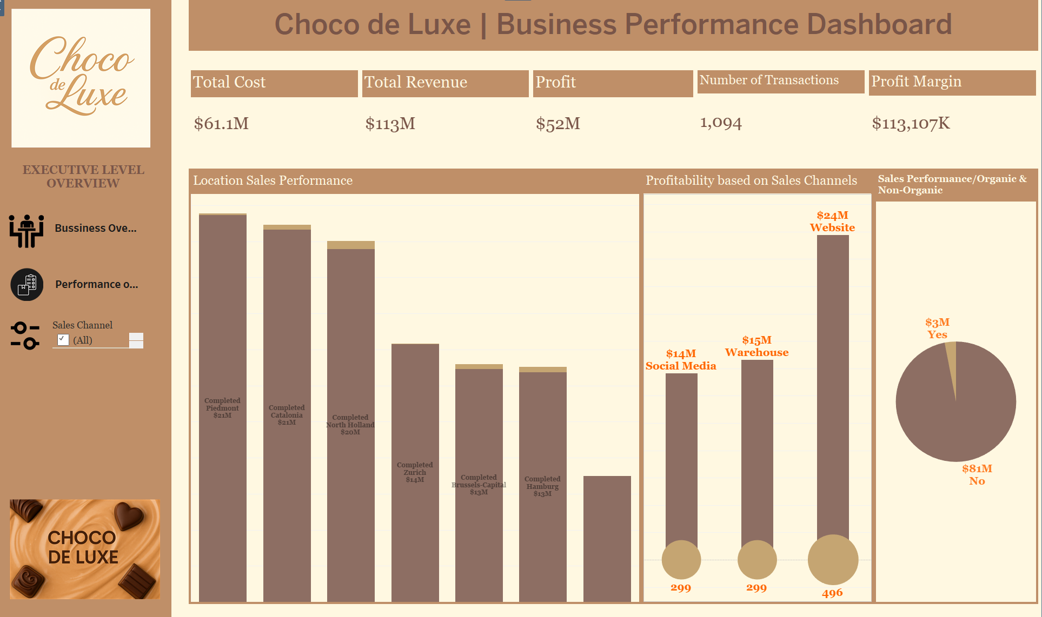
BUSINESS LEVEL OVERVIEW

Slide 14
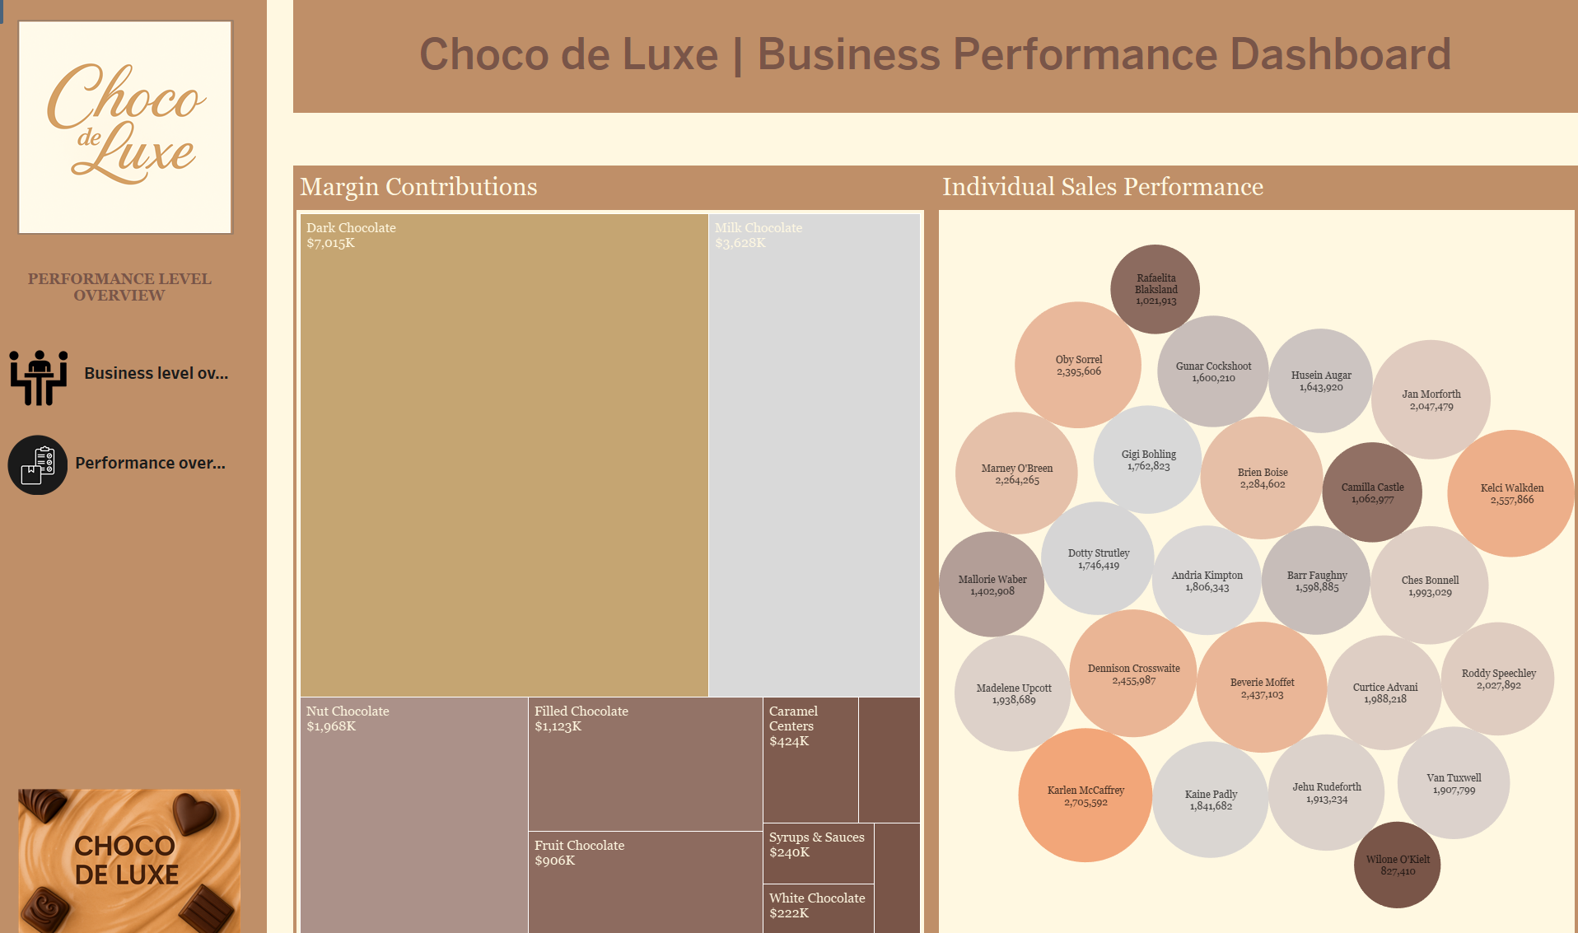
PERFORMANCE LEVEL OVERVIEW

Slide 15

THANK YOU
QUESTIONS WELCOME

